Slide 1

Dota 2 Statistical Analysis
Ragul Paramasivam
Aishwarya Sriyapu Reddy
Kanimozhi Velusamy

Slide 2

Introduction
Dota 2, a widely acclaimed multiplayer online battle arena (MOBA) game, boasts a substantial global fan base.
Annual professional tournaments for Dota 2 have been a tradition since 2010, serving as stages for teams to exhibit their prowess and vie for victory.
These tournaments have evolved into highly anticipated events, fostering intense competition among teams striving for supremacy.
Consequently, there is a burgeoning fascination with scrutinizing the performances of both teams and individual players in these prestigious competitions.

Slide 3
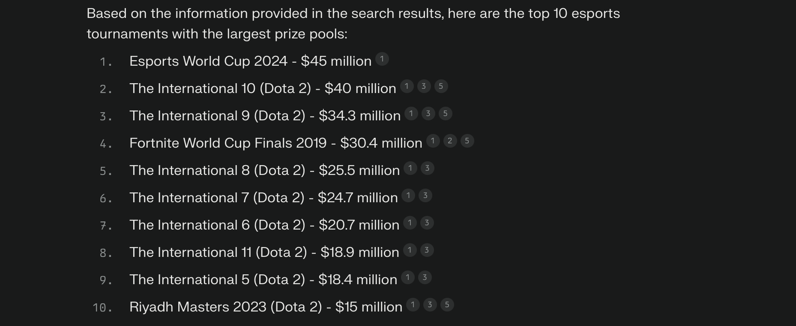

Slide 4
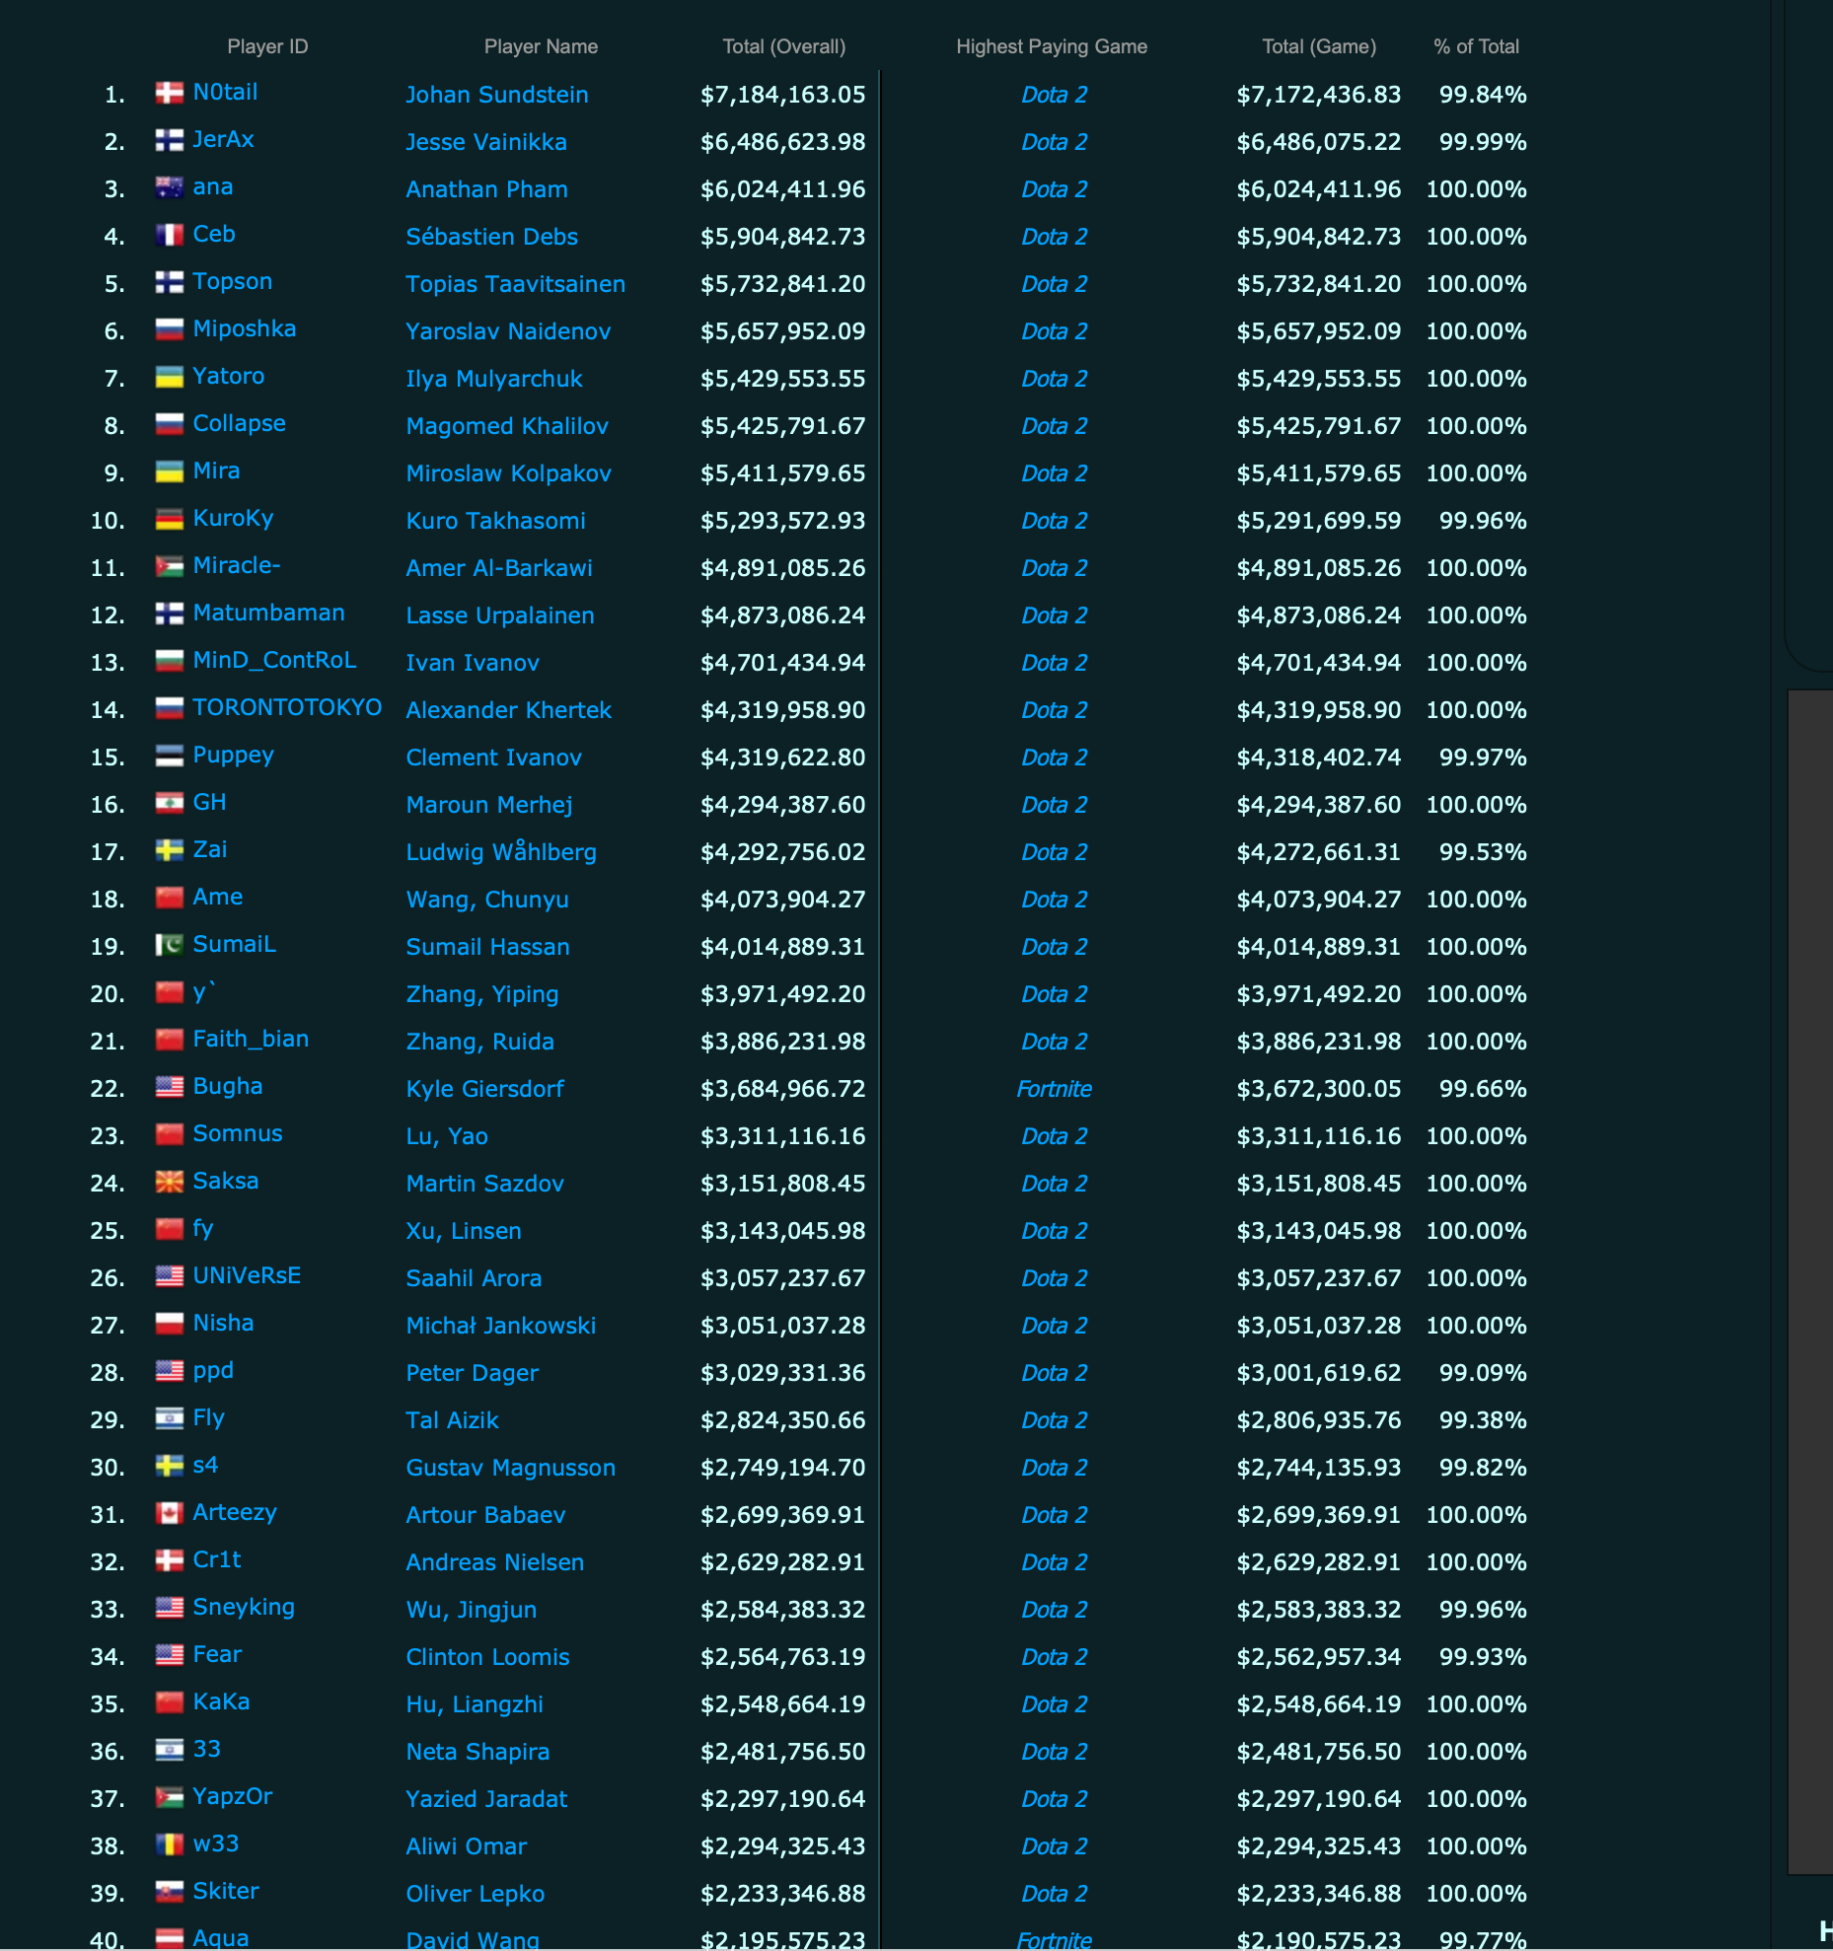

Slide 5
To develop a data engineering and business intelligence project focusing on analyzing Dota 2 matches from professional tournaments.
To utilize the OpenDota API, Apache Spark, and Tableau to gather, process, and visualize the data effectively.
To provide in-depth insights into the performance of teams and players.
To identify key trends and patterns within the data.
To offer actionable recommendations for teams and players to enhance their performance based on the analysis.
Objective/Scope

Slide 6

Architecture Diagram

Slide 7




Data Storage
Data Visualization
Data Source & Extraction
Extraction
Data Orchestration

Slide 8

Entity Relationship Diagram

Slide 9
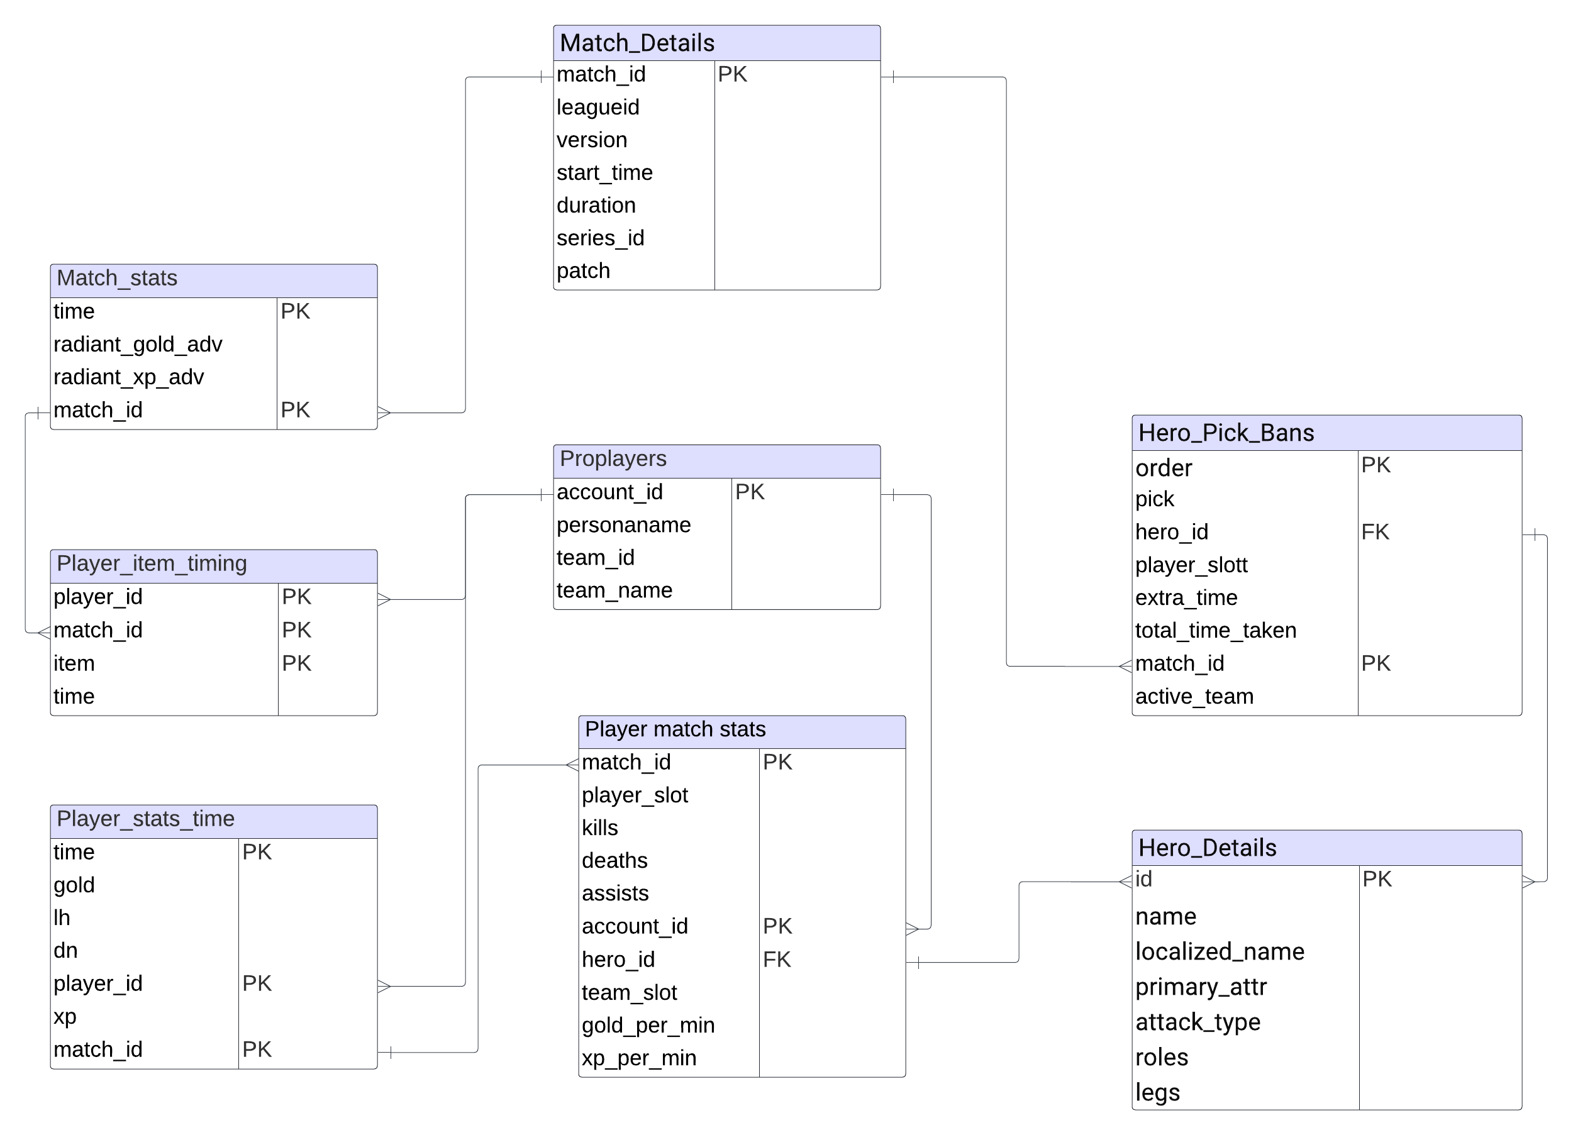

Slide 10
Utilized the OpenDota API as the primary source for collecting data on Dota 2 matches from professional tournaments.
Accessed comprehensive data sets encompassing match details, player statistics, and team performance.
Leveraged the versatility of the OpenDota API to gather a diverse range of information pertinent to the analysis.
Ensured consistent and reliable data retrieval from the API to maintain the integrity of the dataset.
Implemented appropriate data processing techniques to prepare the collected data for subsequent analysis.
Data Collection

Slide 11
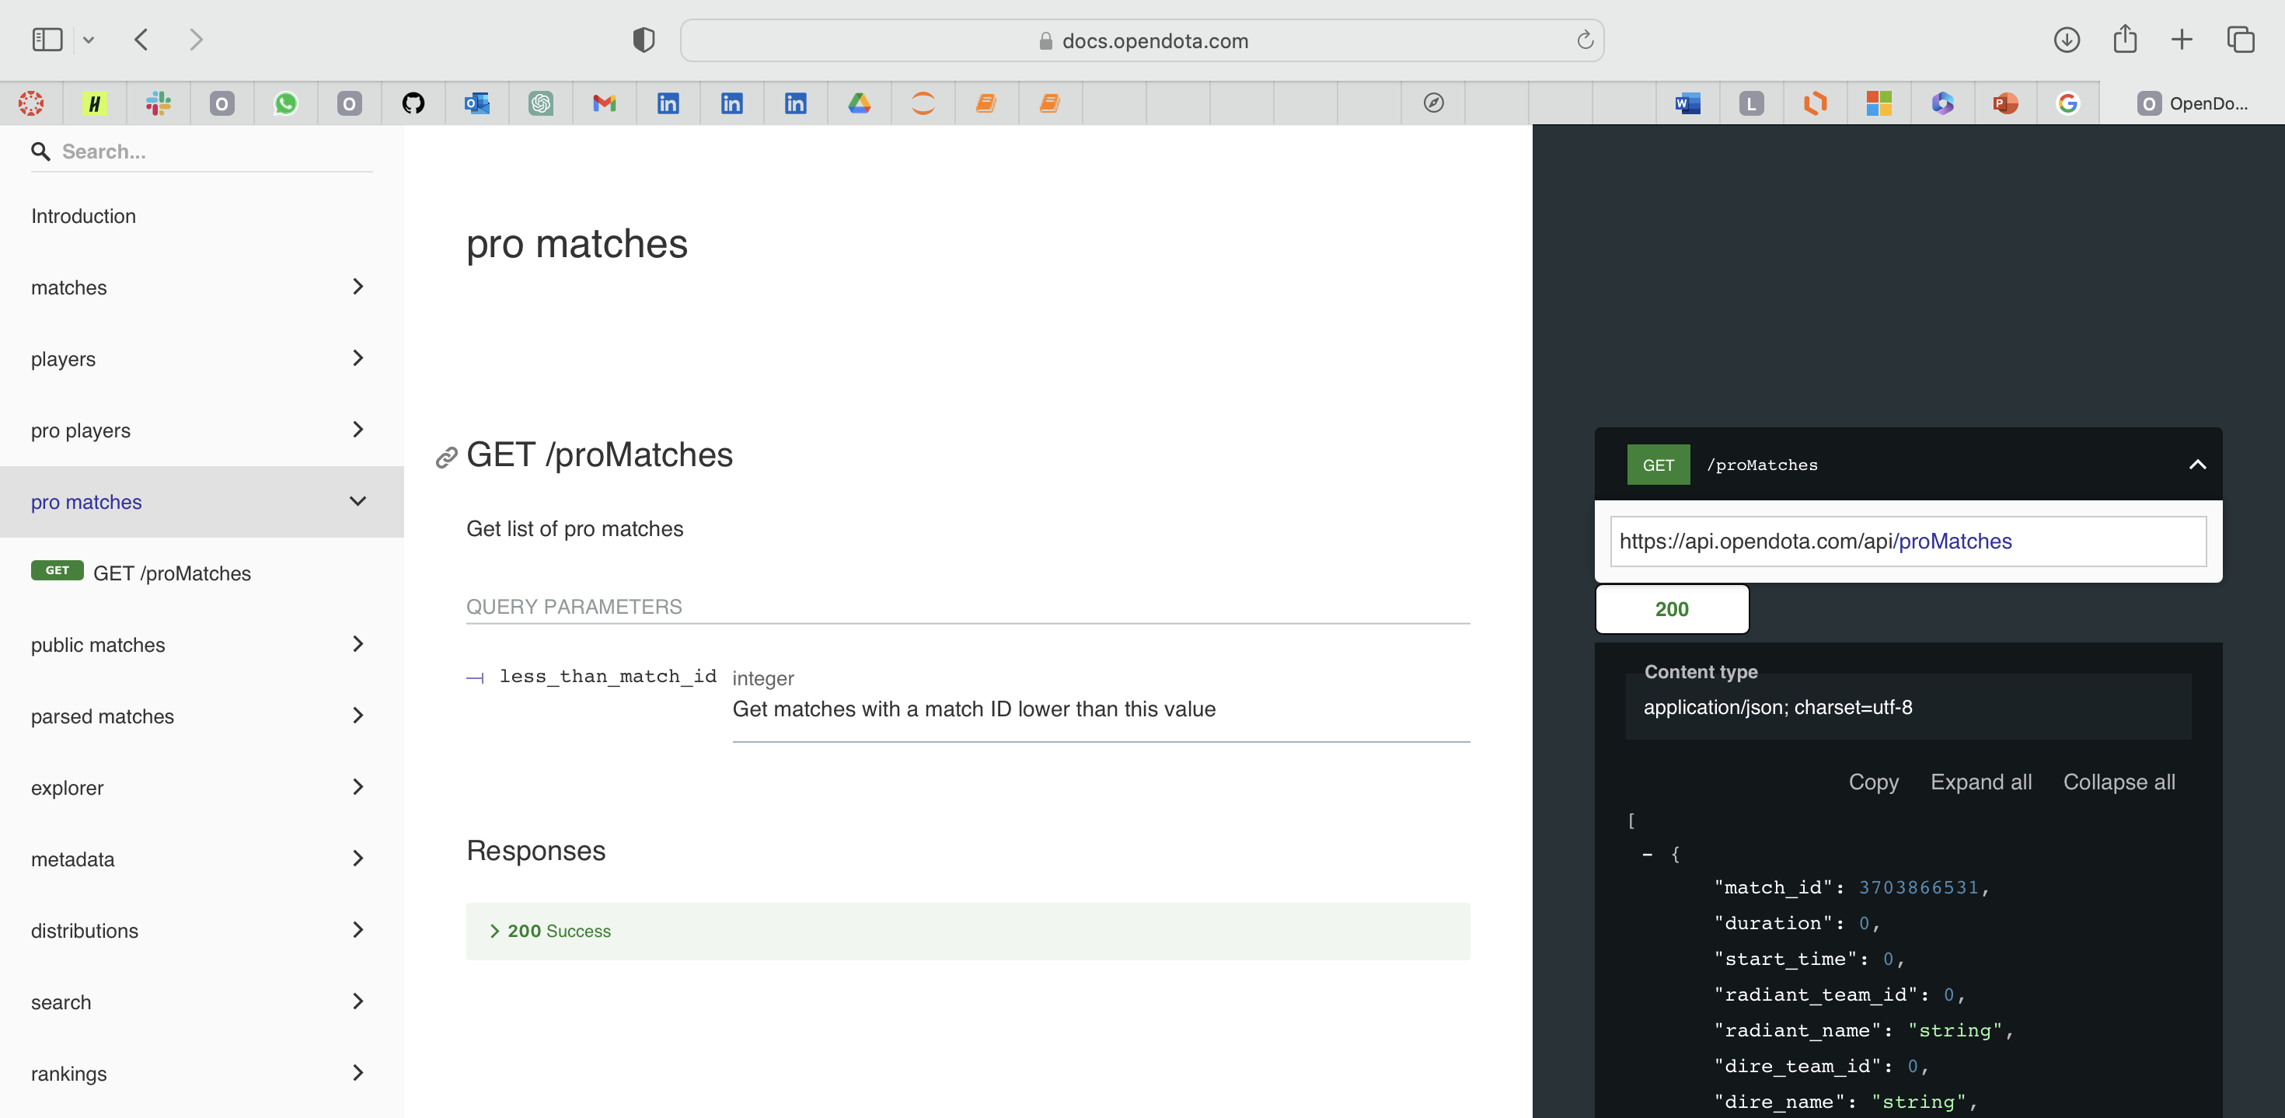

Slide 12
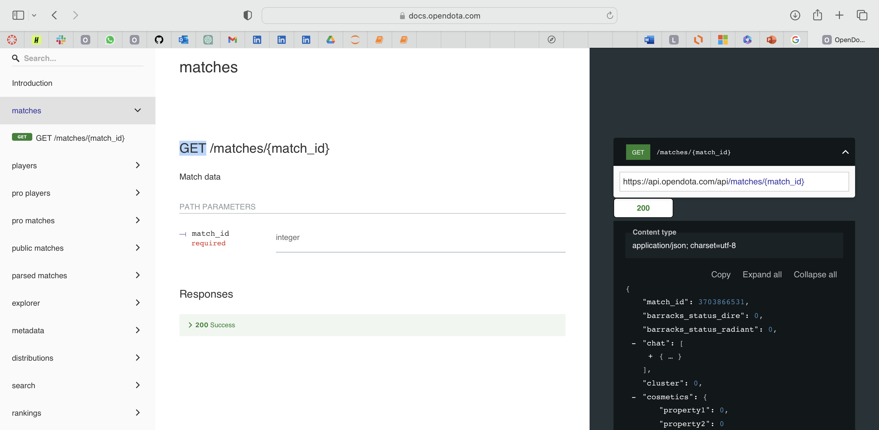

Slide 13
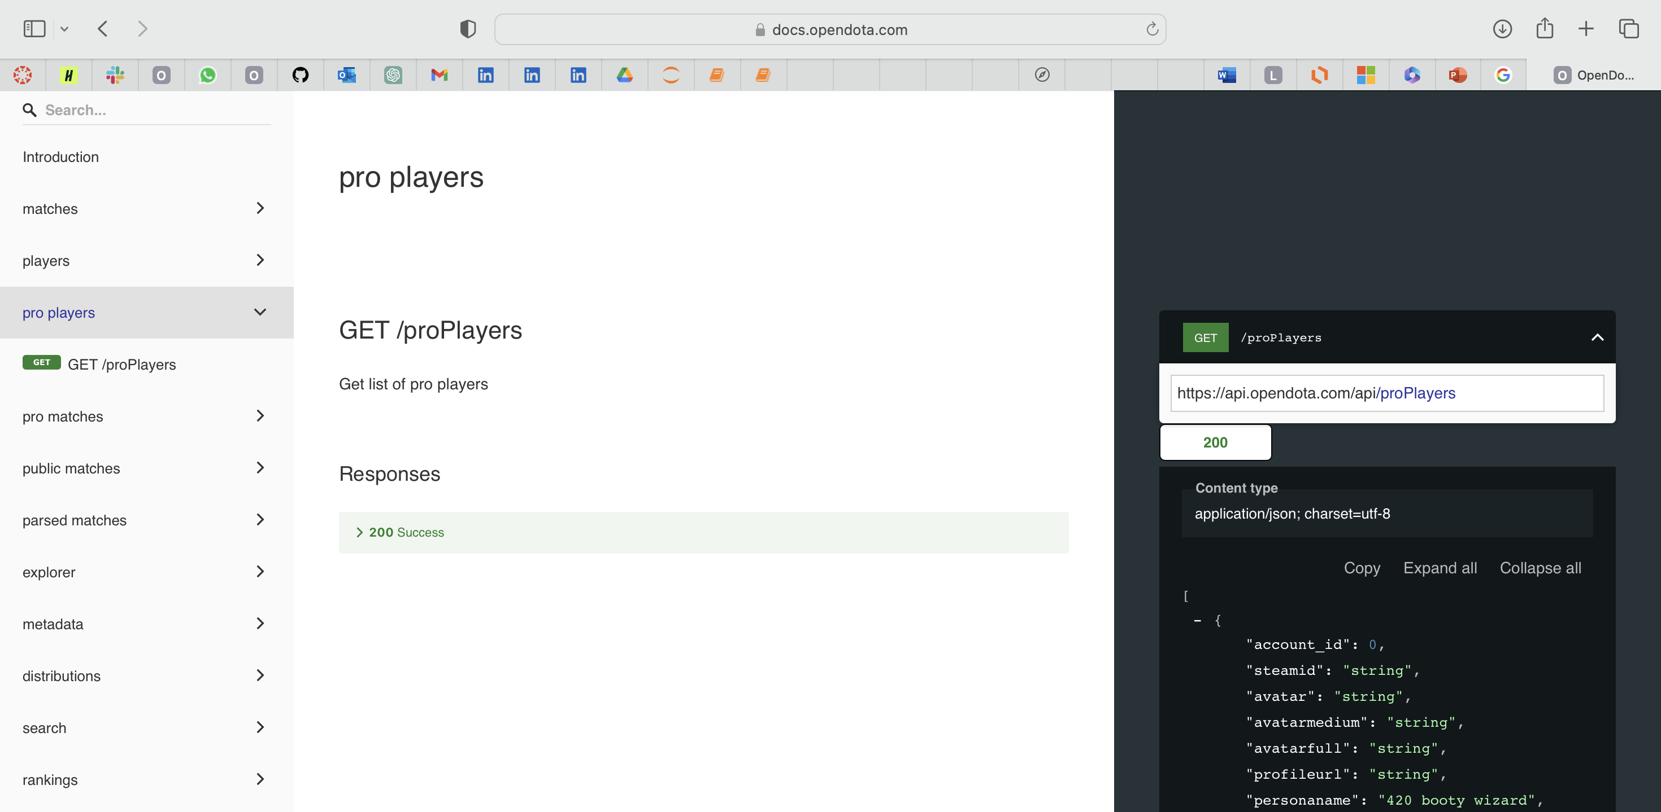

Slide 14
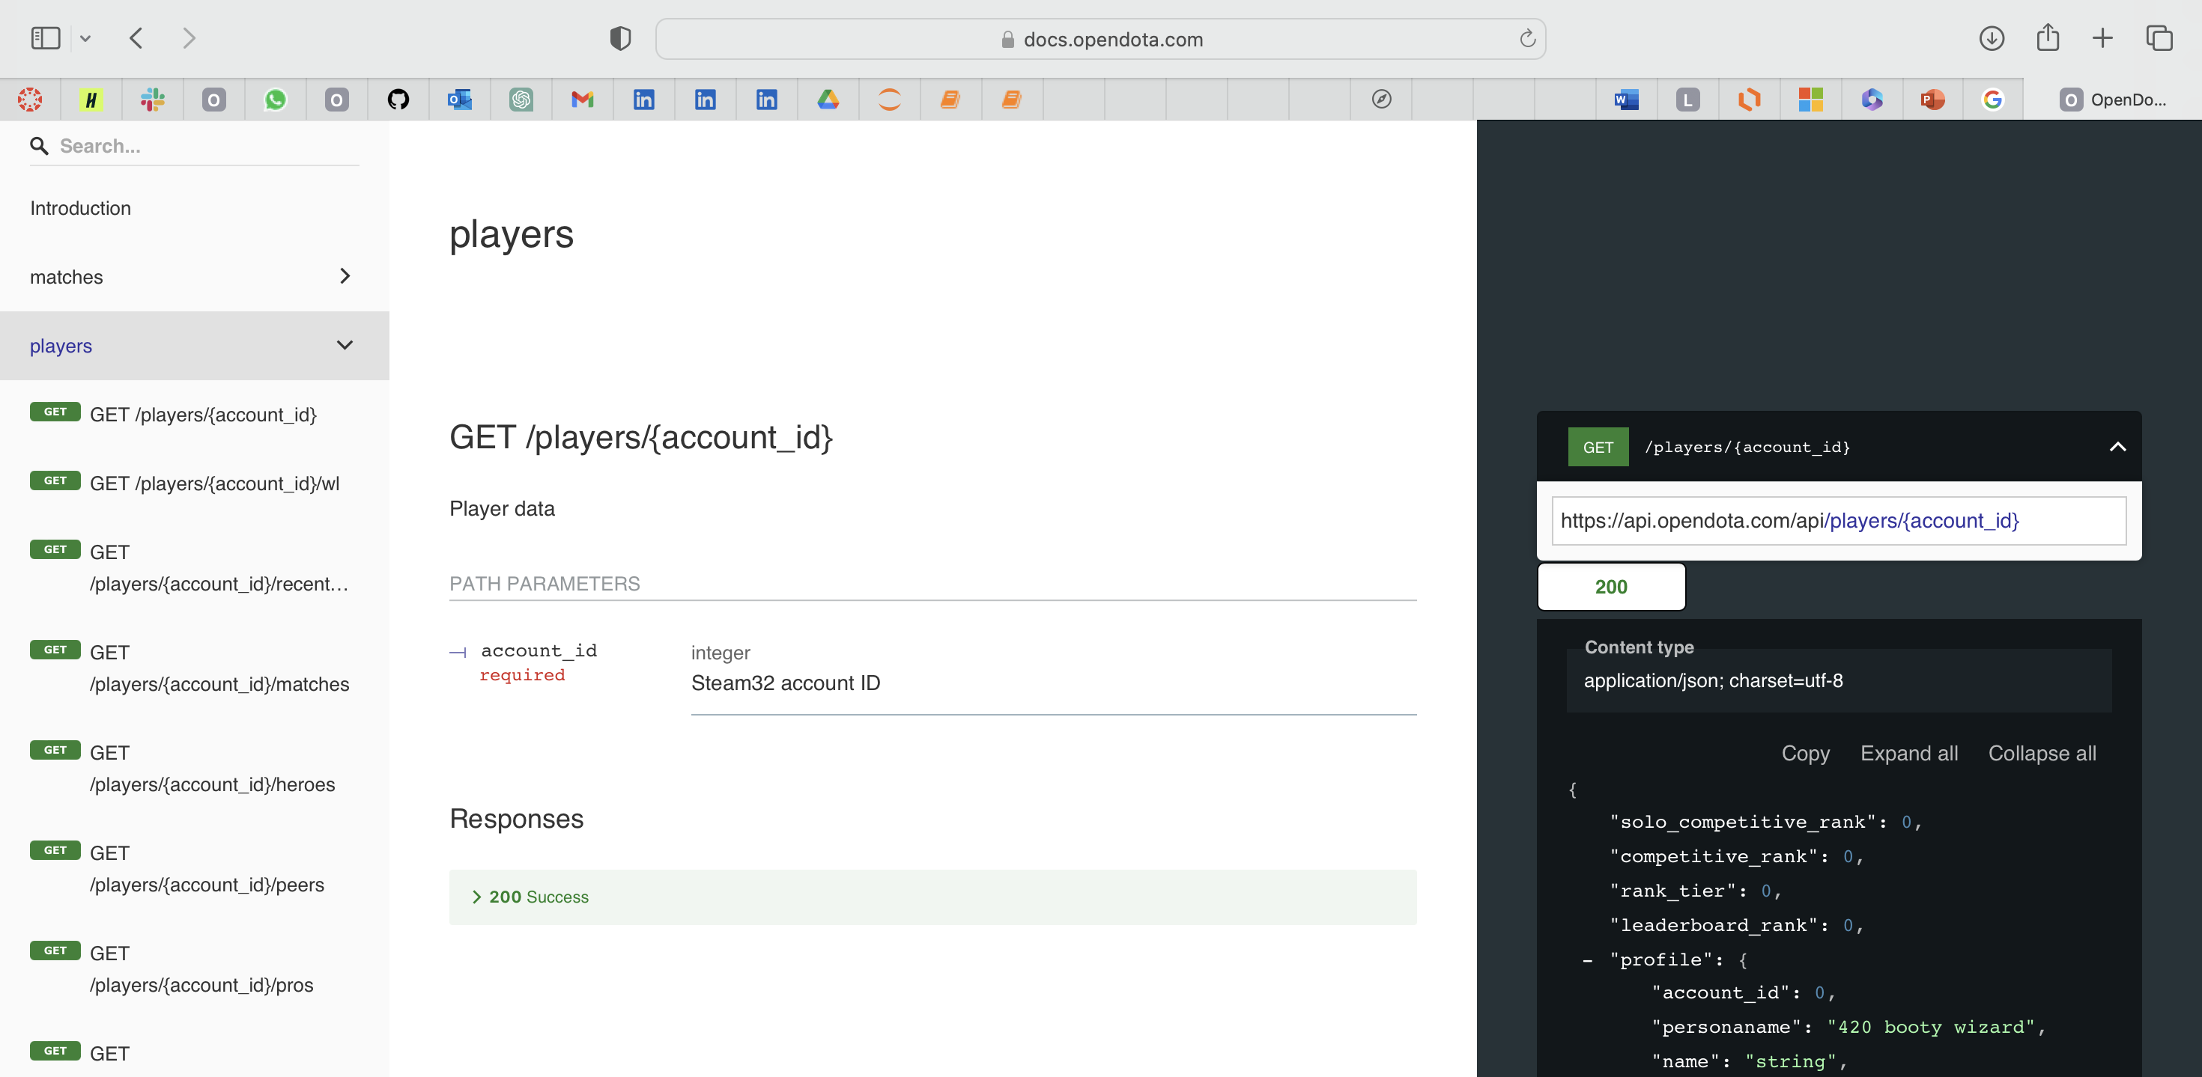

Slide 15
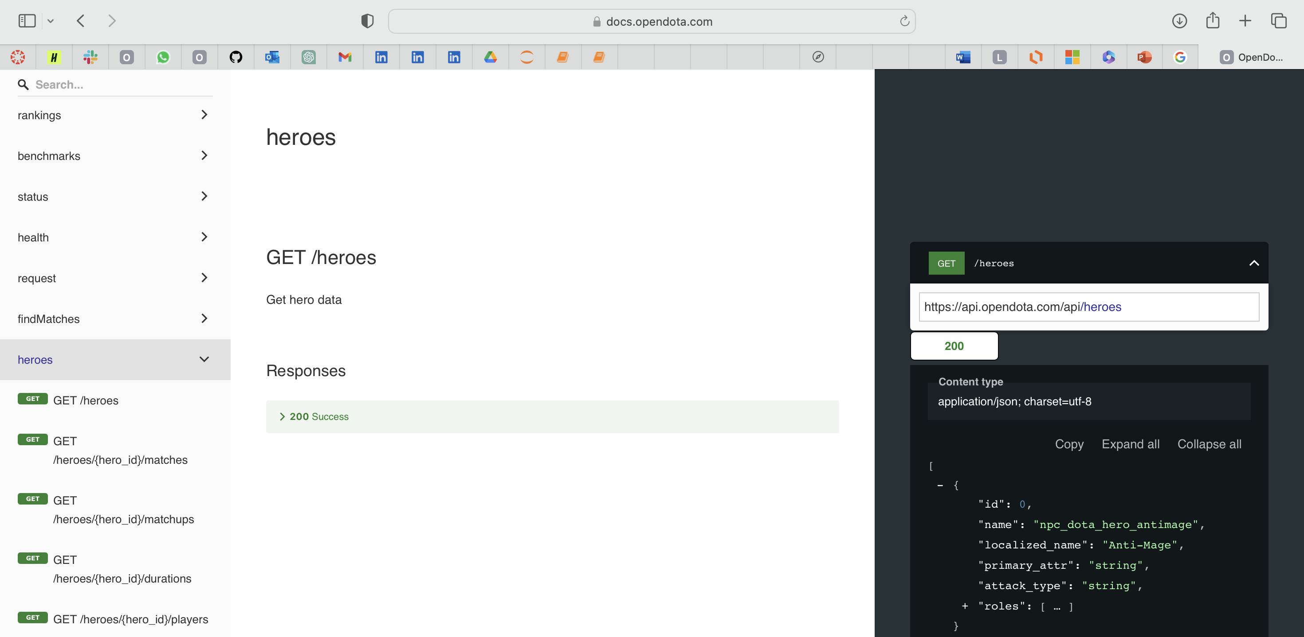

Slide 16
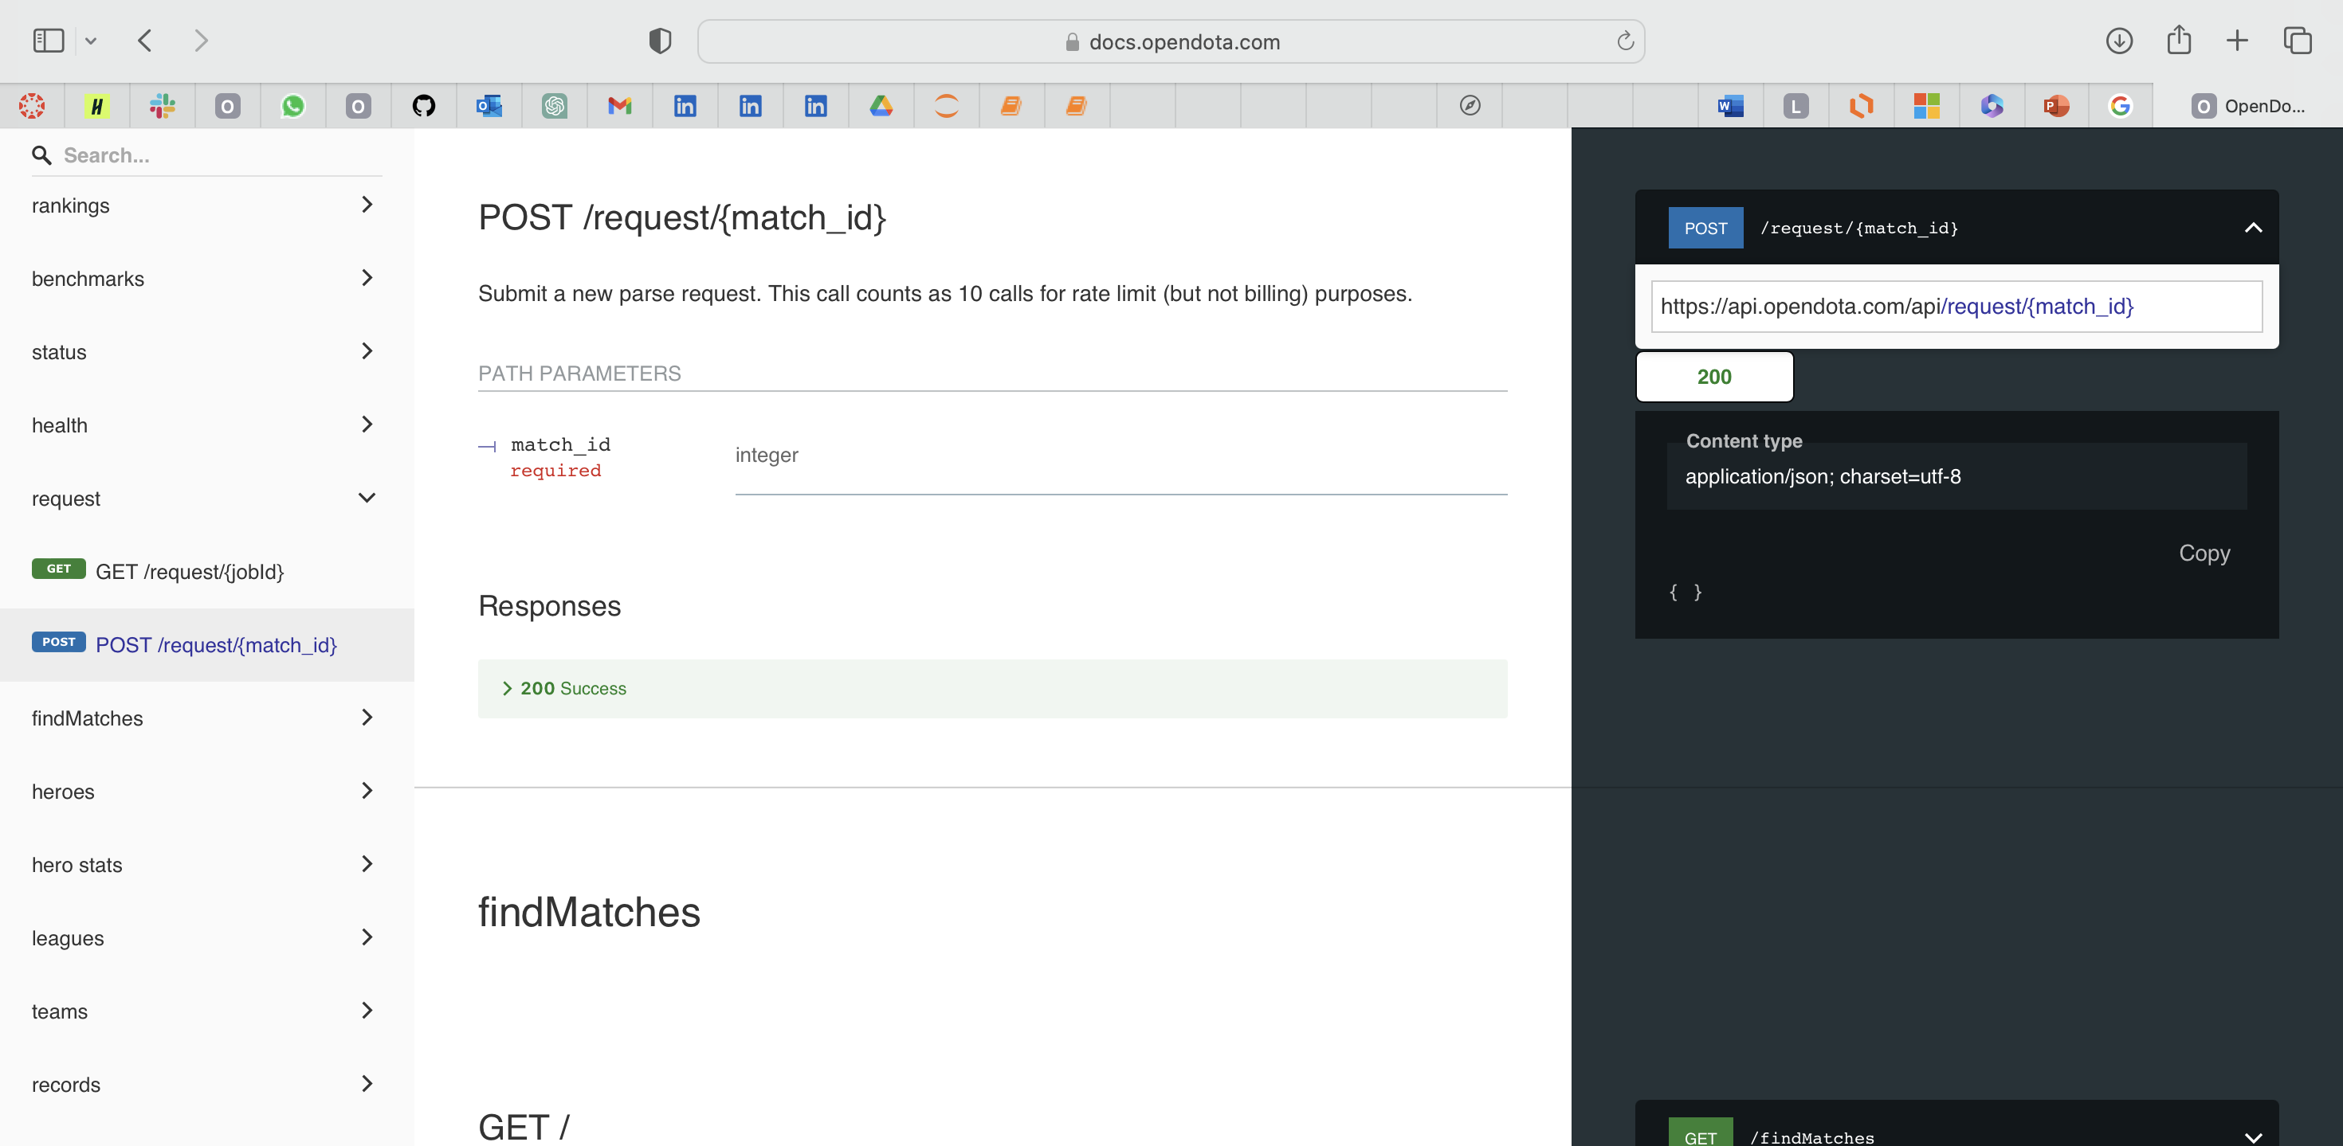

Slide 17
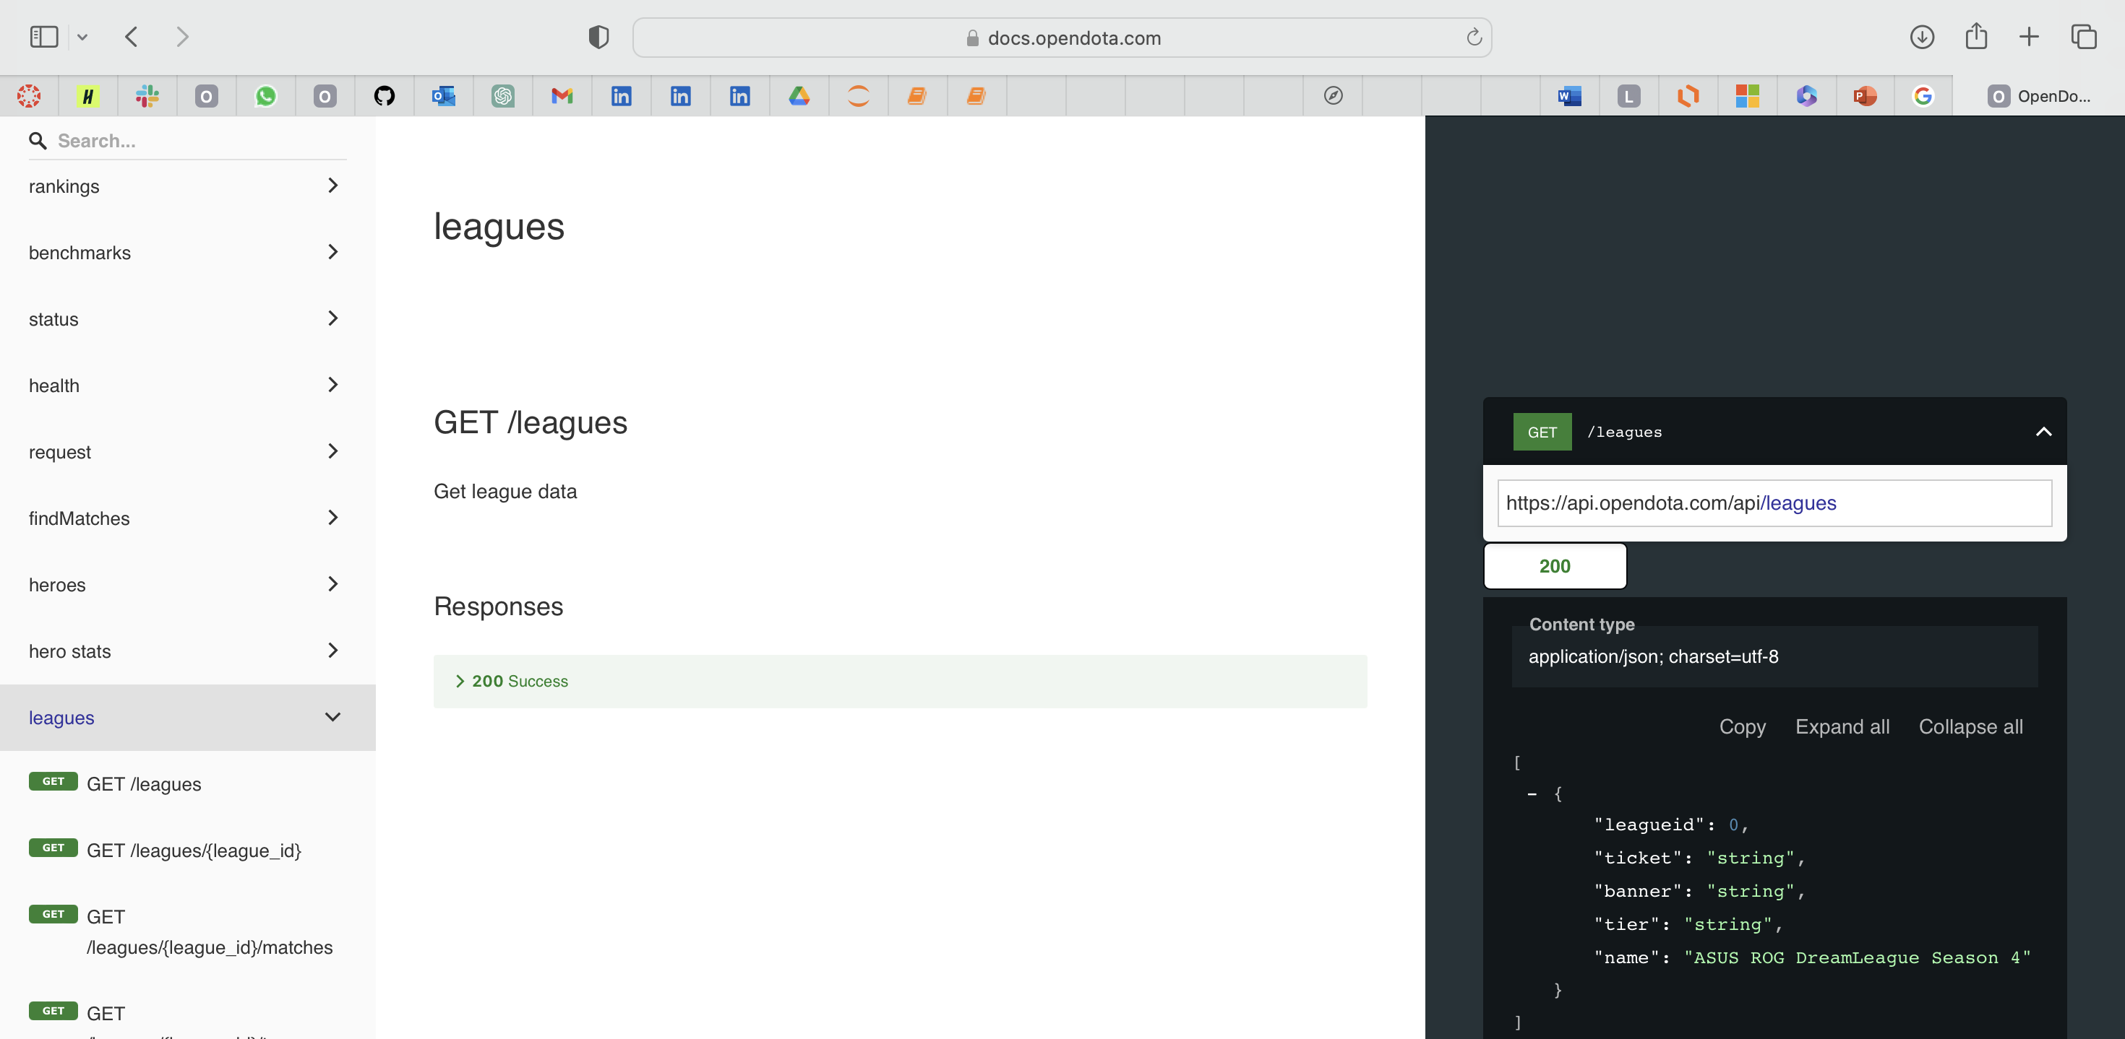

Slide 18
The collected data was cleaned, transformed, and organized into a format suitable for analysis.
Missing values, outliers, and data inconsistencies were addressed during the preprocessing stage.
Techniques such as imputation, filtering, and normalization were employed to handle missing values, outliers, and inconsistencies.
Data integrity and quality were maintained through rigorous preprocessing procedures.
The preprocessed data was structured and formatted to facilitate seamless analysis using subsequent tools and techniques.
Data Processing

Slide 19

Code in Databricks

Slide 20

Data Storage
PostgreSQL was employed as the primary database management system for storing the extensive dataset of Dota 2 matches from professional tournaments.
The utilization of PostgreSQL offered several advantages, including robust data storage capabilities, reliability, and support for complex queries.
Data related to match details, player statistics, team performance, and other relevant information were efficiently organized and stored within PostgreSQL tables, ensuring data integrity and accessibility.
Overall, the use of PostgreSQL as the underlying data storage solution played a crucial role in enabling the project to effectively collect, manage, and analyze Dota 2 tournament data, ultimately leading to the generation of valuable insights and recommendations for improvement.

Slide 21
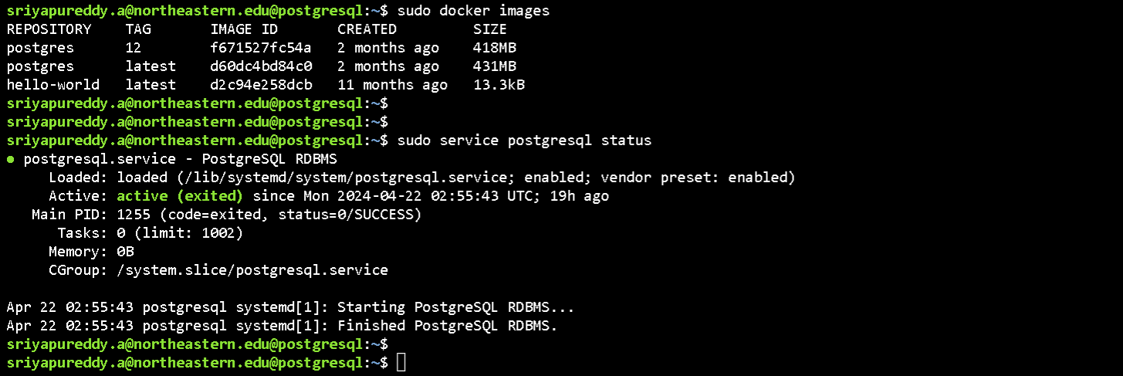
PostgreSql Setup

Slide 22
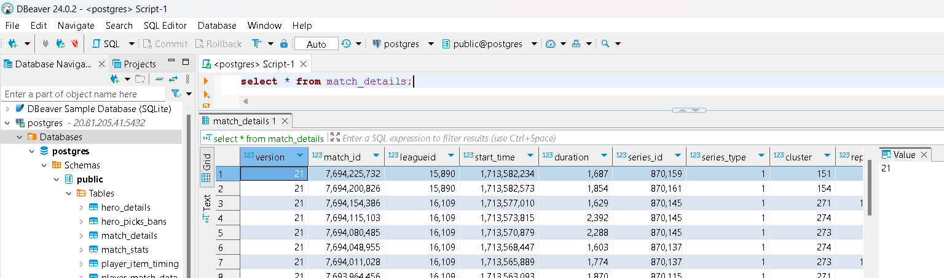

Slide 23
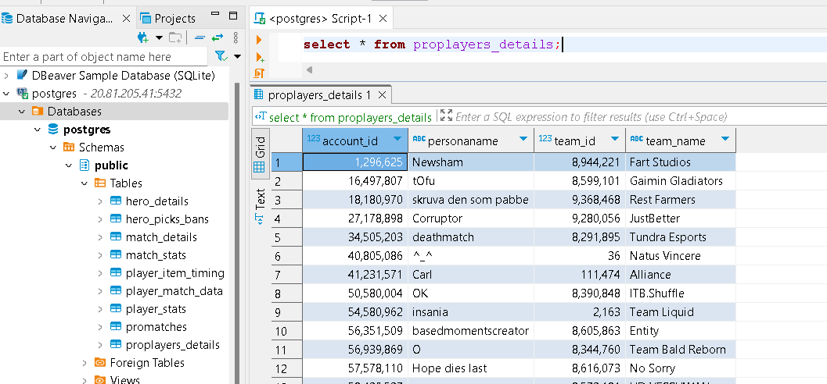
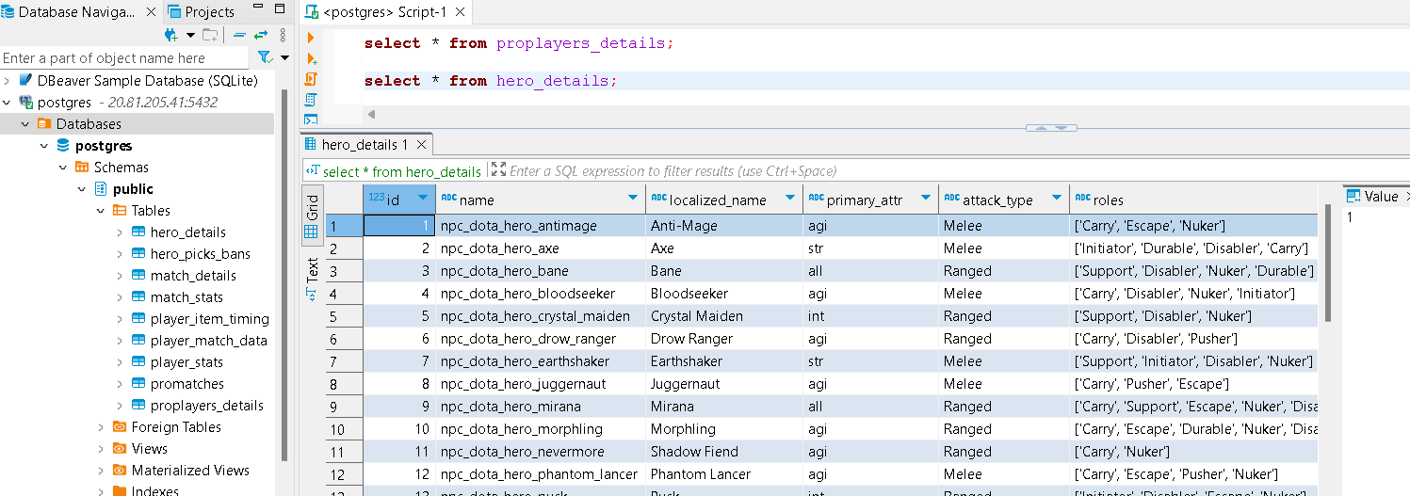

Slide 24
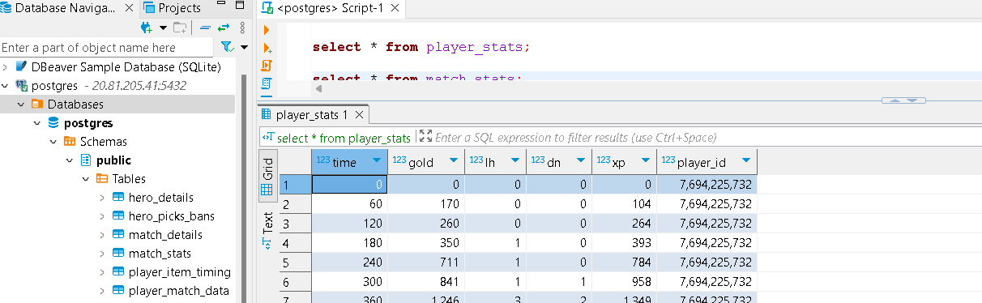
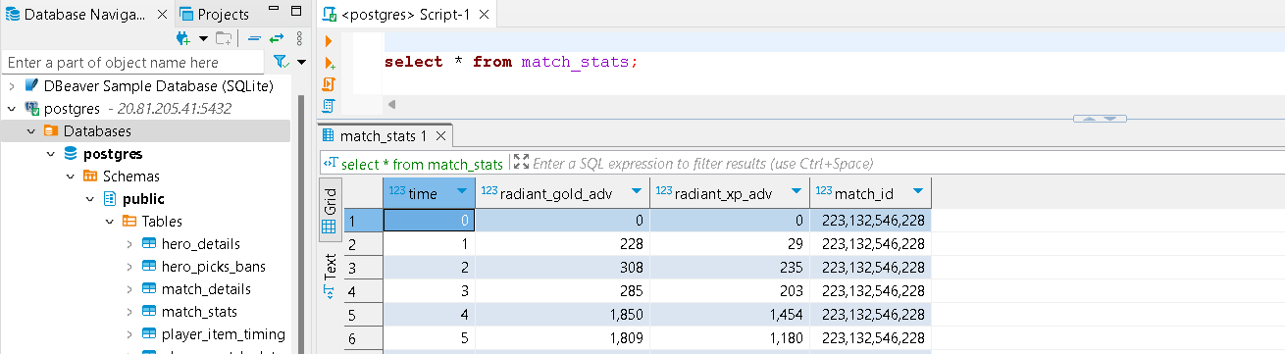

Slide 25
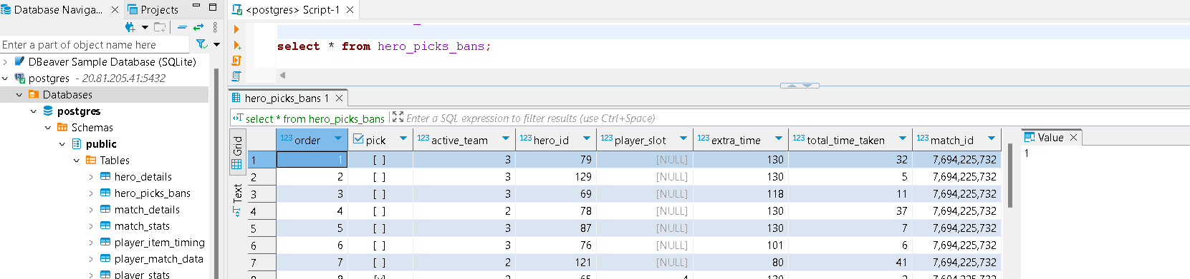
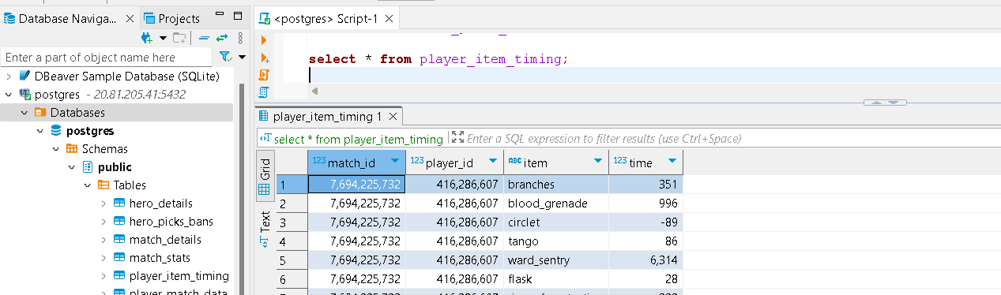

Slide 26
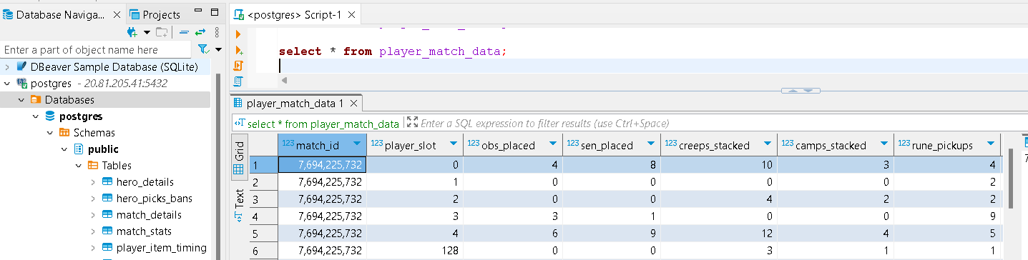
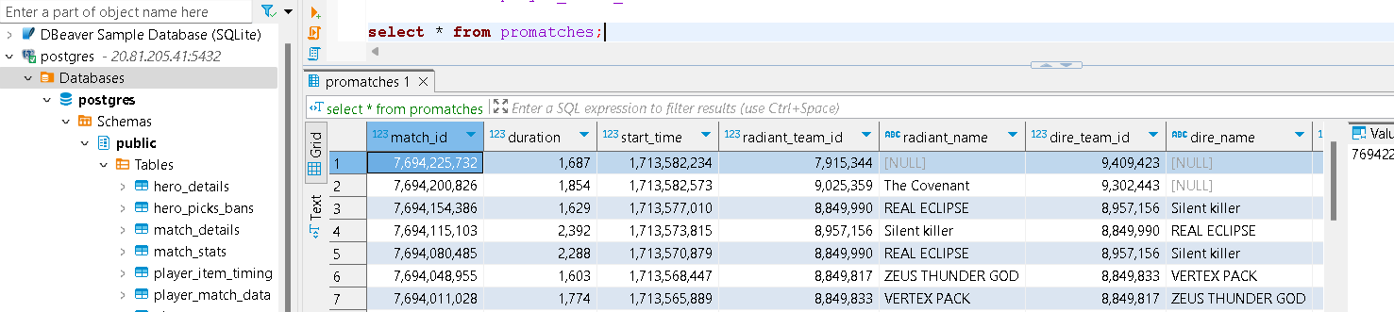

Slide 27

Data Analysis
Team Performance Analysis
The project analyzed the performance of teams in professional Dota 2 tournaments by calculating metrics such as win, kill, and economic rates.
Trends and patterns in team performance were identified to provide recommendations for improvement.
Player Performance Analysis
Individual player performance in professional Dota 2 tournaments was analyzed by calculating metrics like kill, death, and gold rates.
Trends and patterns in player performance were identified to offer recommendations for improvement.
Match Outcome Prediction
Machine learning algorithms were utilized to predict the outcome of Dota 2 matches.

Slide 28
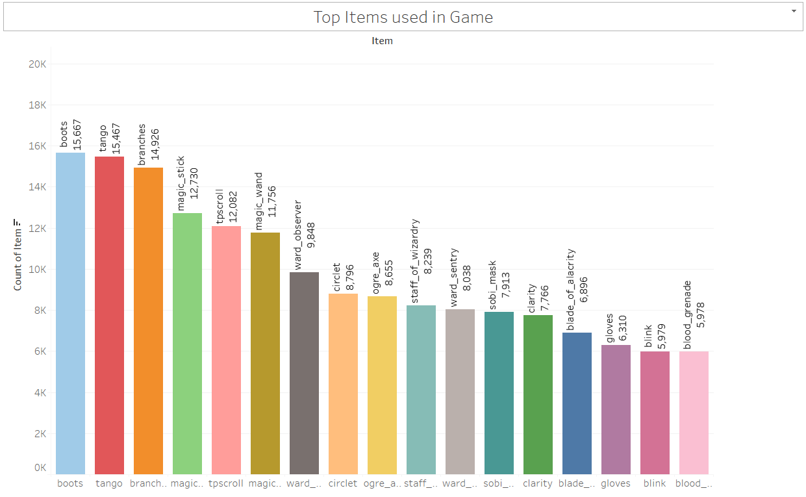

Slide 29
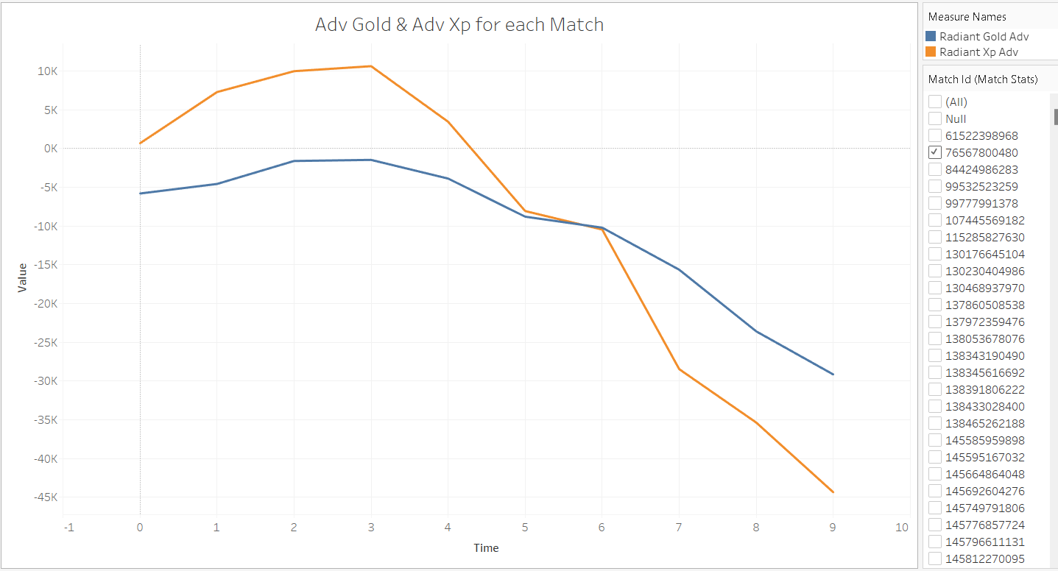

Slide 30
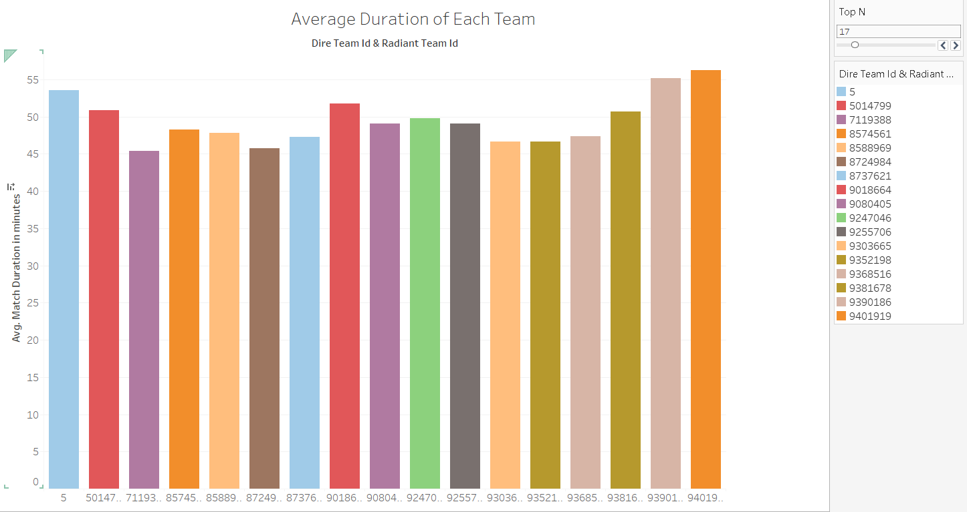

Slide 31
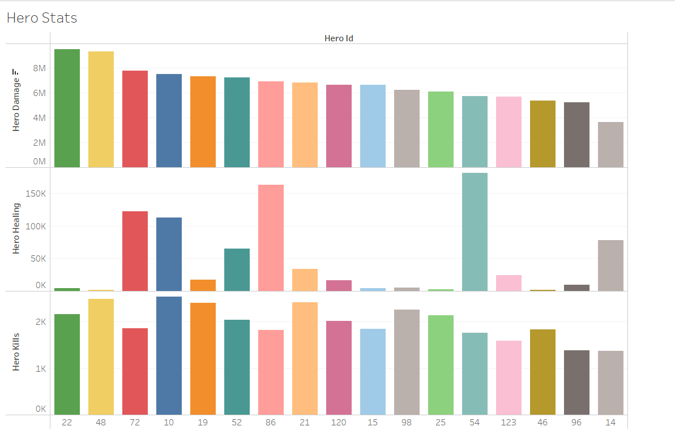

Slide 32
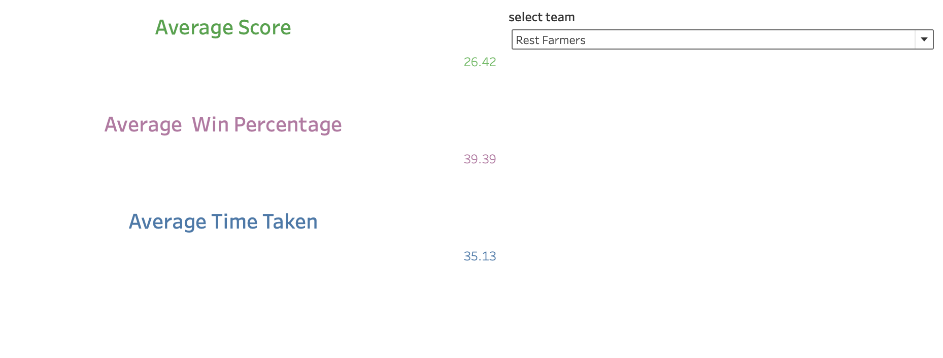

Slide 33
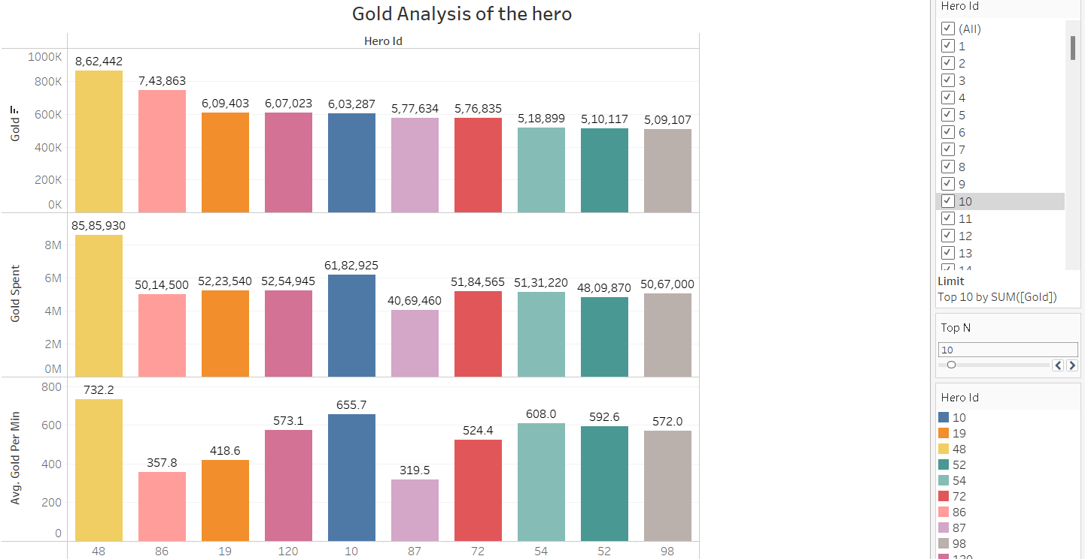

Slide 34
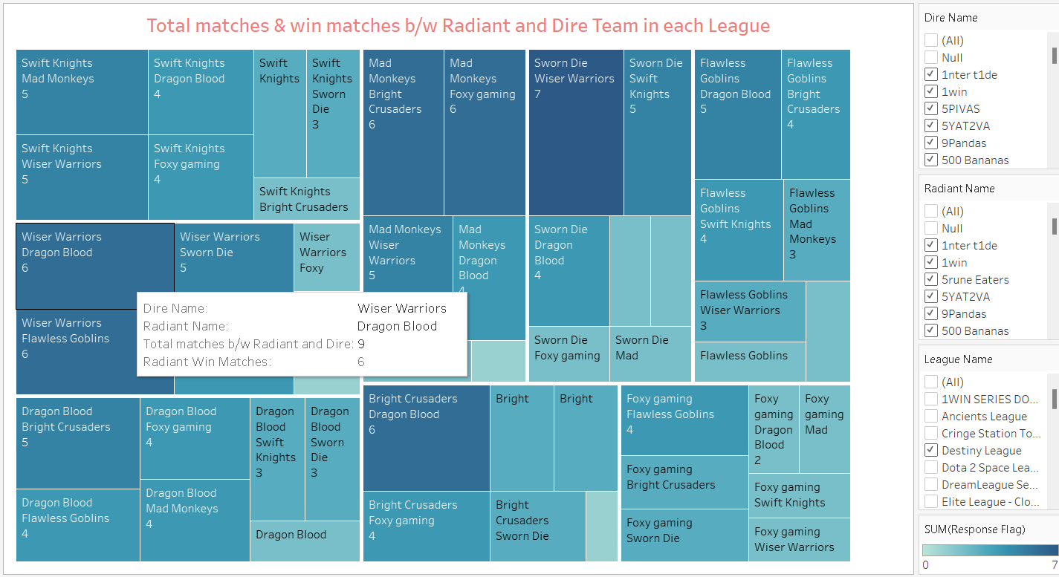

Slide 35
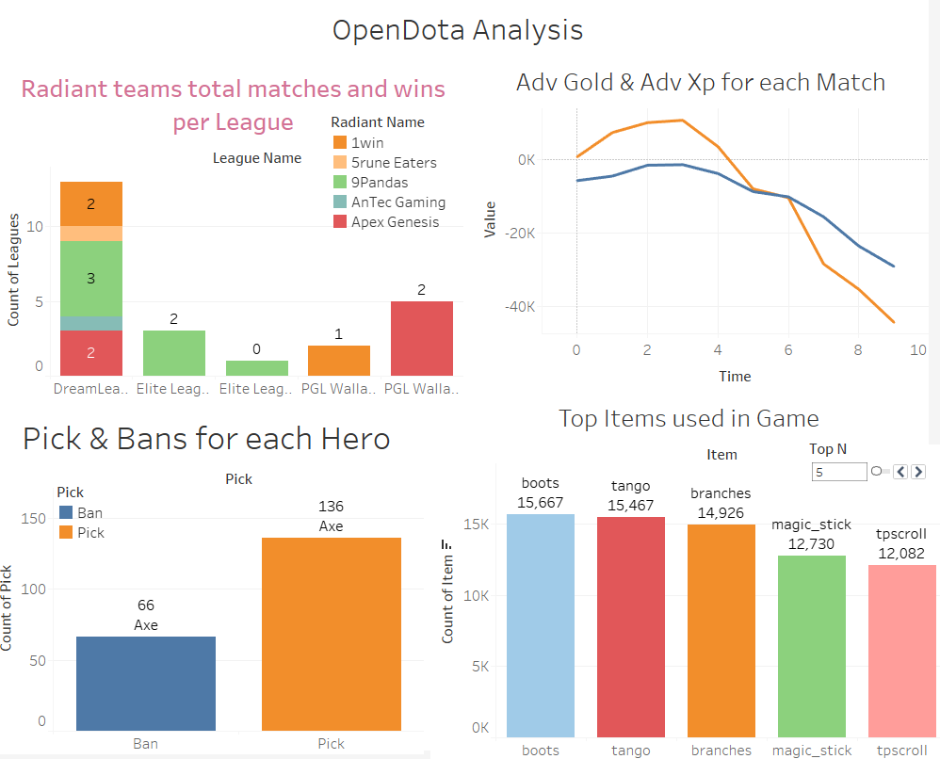

Slide 36

Machine Learning

Slide 37
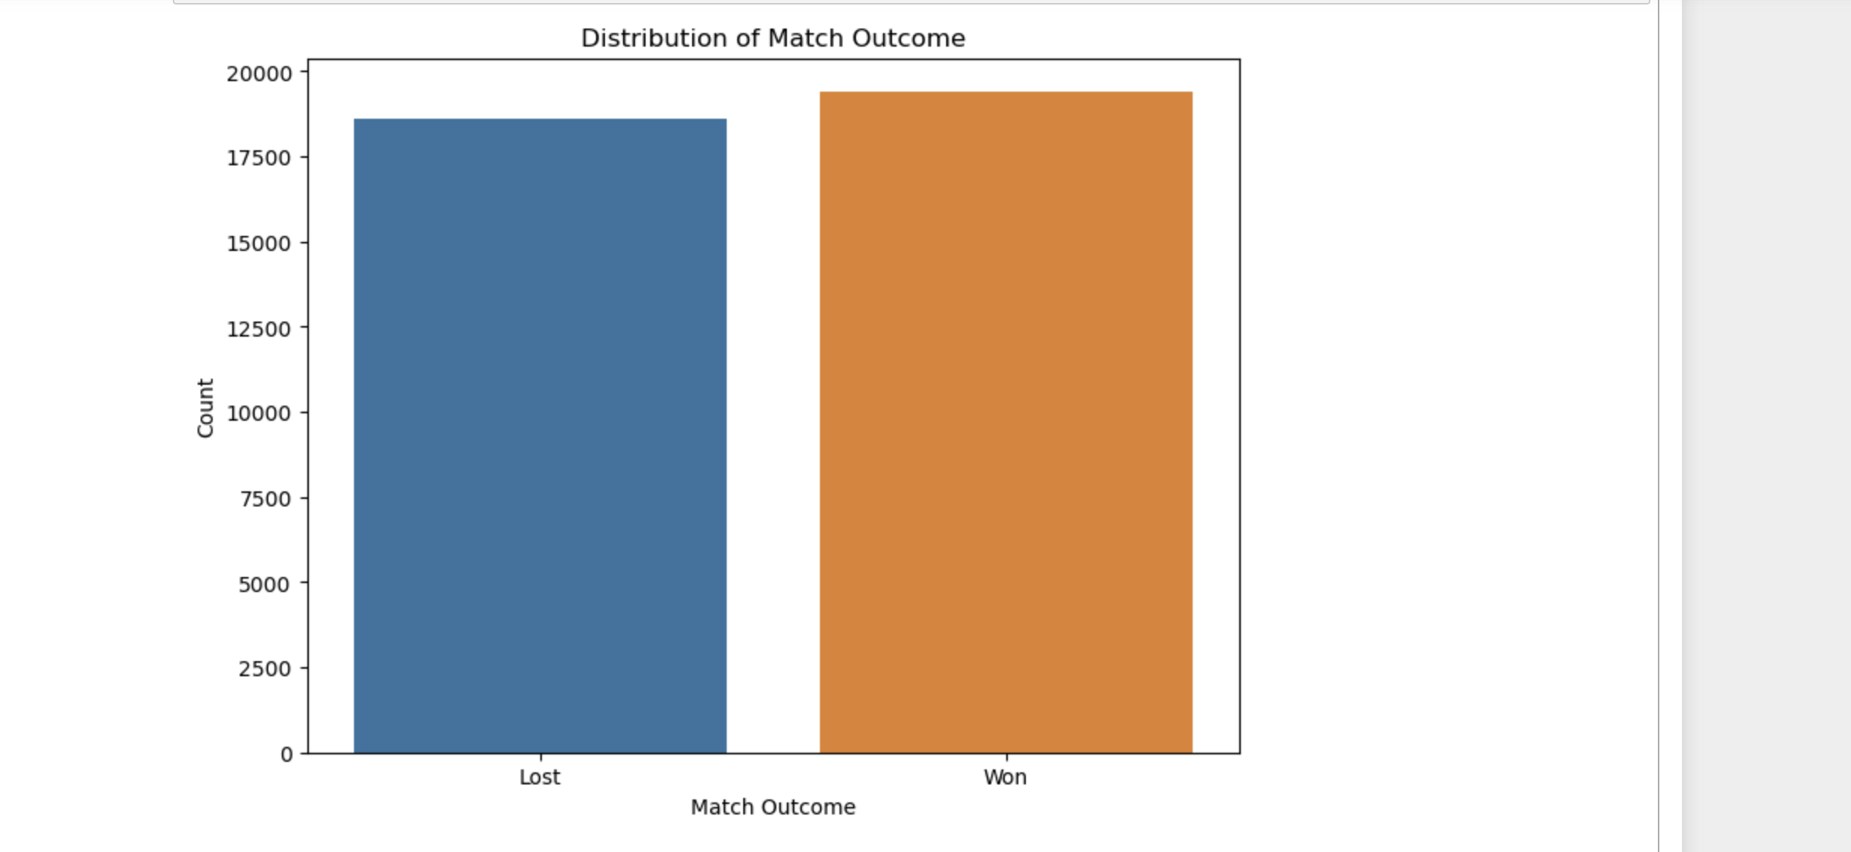

Slide 38
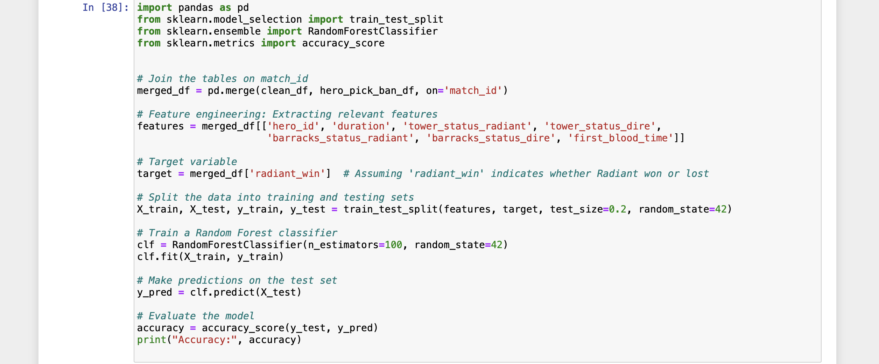
Confusion Matrix
Accuracy: 0.915
3047 | 283
346 | 3724

Slide 39
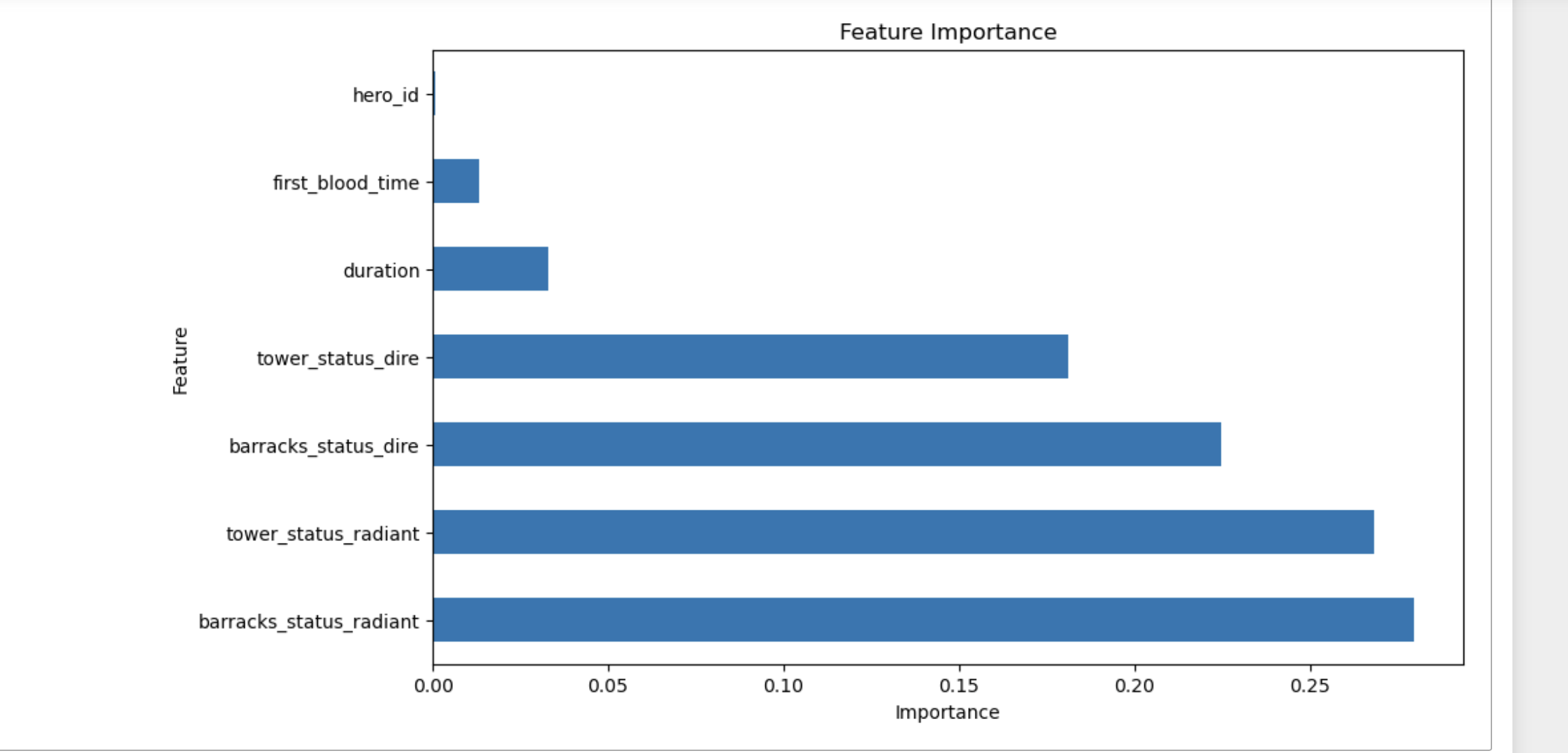

Slide 40
Scope for improvement
Use Spark metrics tools to find performance improvement and reduce cost.
Create more dashboards specifically focusing on item timings and situation at which item bought.
Analyse comeback and stomp matches
Expanding the data and workflow to analyze public matches for specific accounts

Slide 41
Conclusion
The project successfully delivered valuable insights into the performance dynamics of both teams and individual players within professional Dota 2 tournaments. This encompassed a deep dive into various aspects of gameplay, strategy, and execution.
Leveraging the capabilities of the OpenDota API, Apache Spark, and Tableau, the project achieved a high level of sophistication in its analytical approach. This allowed for the comprehensive exploration of multifaceted datasets and the extraction of meaningful patterns.
Through meticulous analysis of a substantial dataset comprising Dota 2 matches, the project unearthed actionable recommendations aimed at enhancing performance across different dimensions. These recommendations were grounded in empirical evidence drawn from the data.
The project's thorough examination of team and player performance yielded valuable insights into underlying trends and patterns within the Dota 2 competitive landscape. Additionally, the development of a machine learning model for outcome prediction represented a significant milestone, offering potential for informed decision-making in future matches and tournaments.

Slide 42

Thank you

